Slide 1
CSE322
Minimization of finite Automaton & REGULAR LANGUAGES
Lecture #5

Slide 2
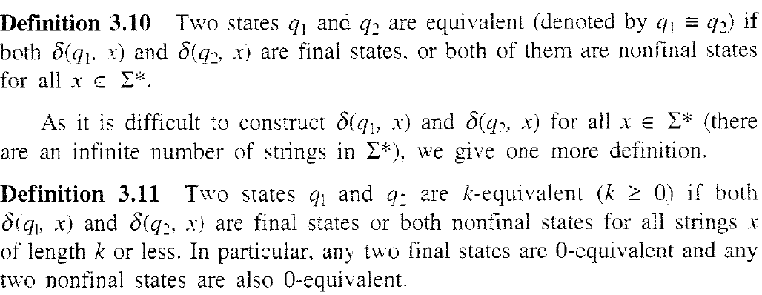
Definitions

Slide 3
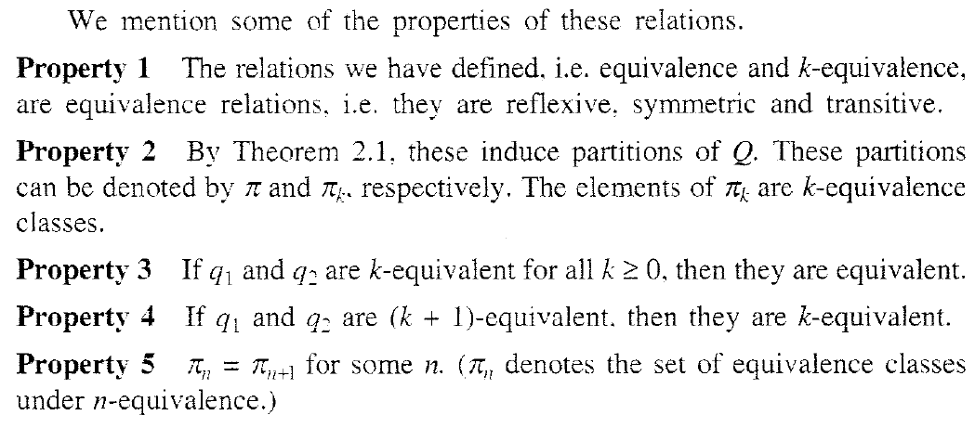
Properties

Slide 4
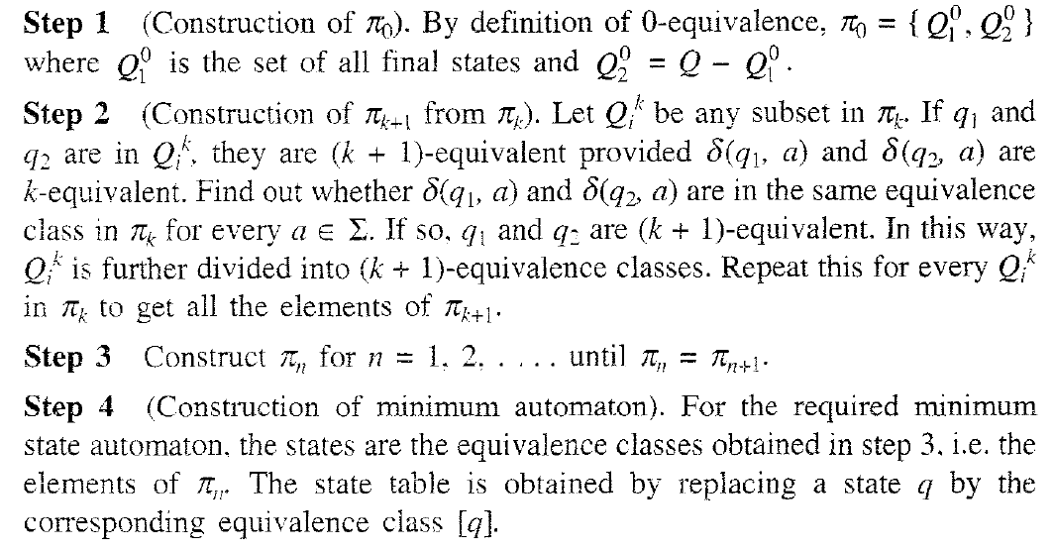
Construction of Minimum Automaton

Slide 5


Slide 6
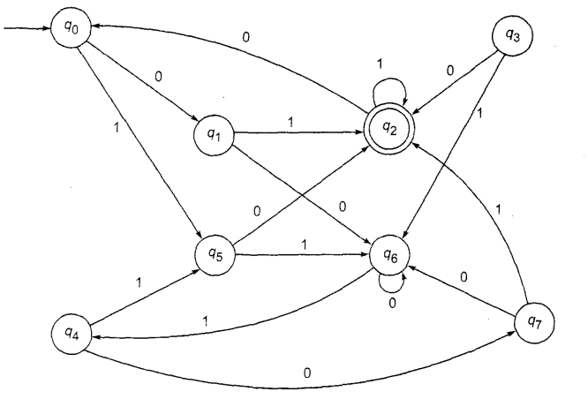
Problem
Construct a minimum state automaton equivalent to finite automaton

Slide 7
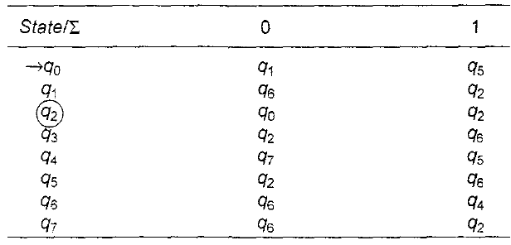

Slide 8
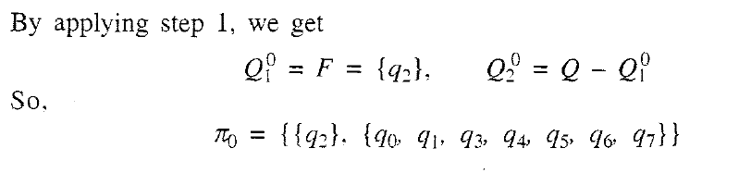

Slide 10
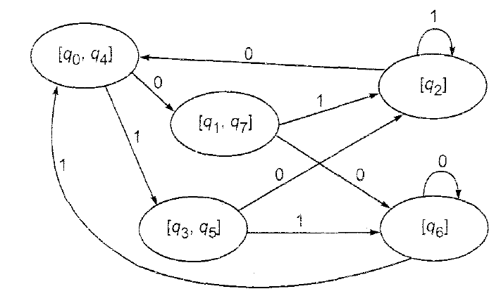
Solution

Slide 11
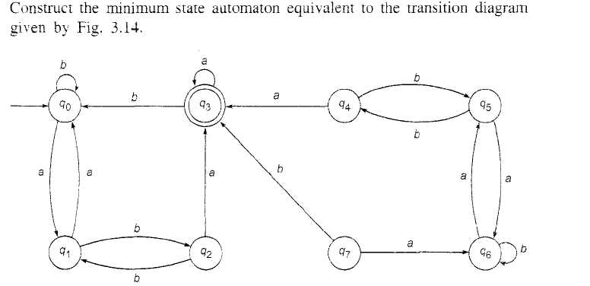

Slide 12
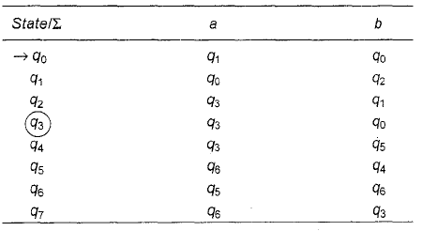

Slide 14
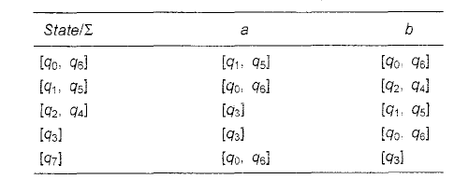

Slide 15
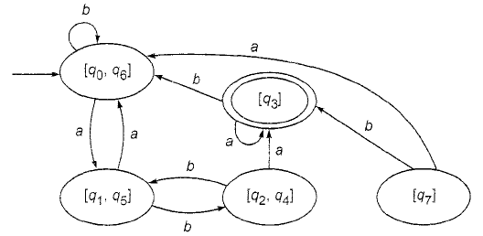

Slide 16
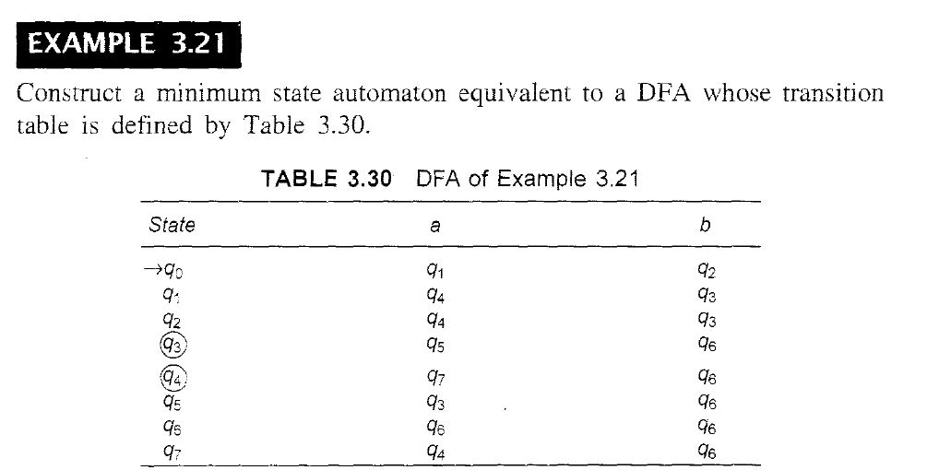
Minimize the given automata

Slide 17


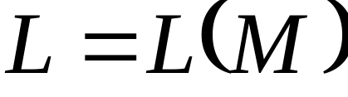
Regular Languages
Definition:
A language is regular if there is
FA such that
Observation:
All languages accepted by FAs
form the family of regular languages

Slide 18
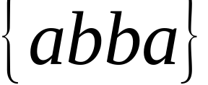
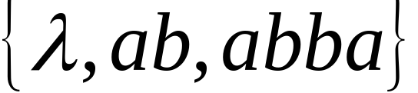
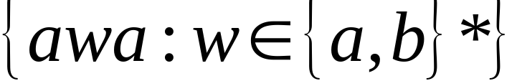
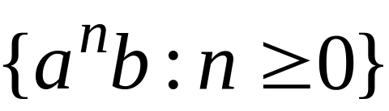


Examples of regular languages:
{ all strings with prefix }
{ all strings without substring }
There exist automata that accept these
Languages (see previous slides).

Slide 19
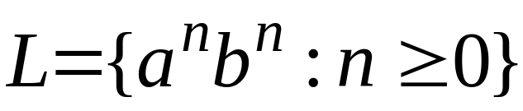
There exist languages which are not Regular:
Example:
There is no FA that accepts such a language
(we will prove this later in the class)

